Slide 1


XIP: The eXtensible Imaging Platform Development Program
Lawrence Tarbox, Ph.D.
Mallinckrodt Institute of Radiology
Washington University in St. Louis

Slide 2

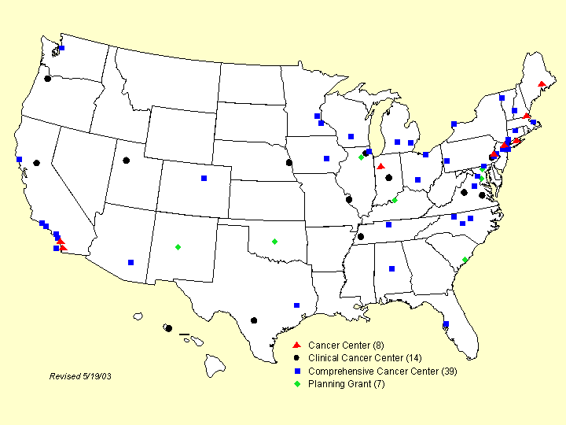
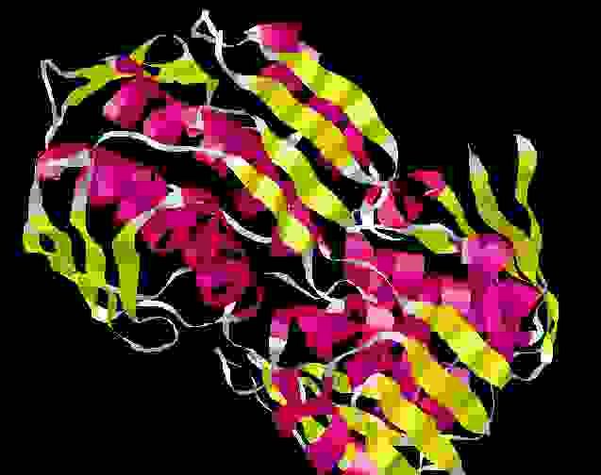
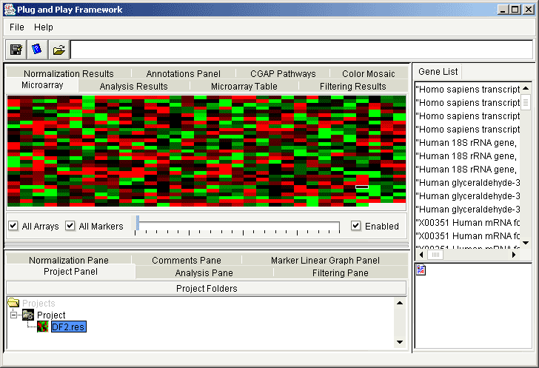
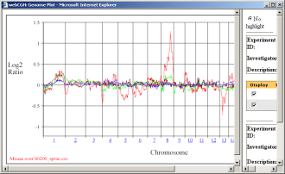
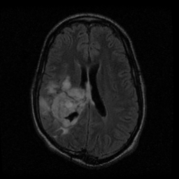
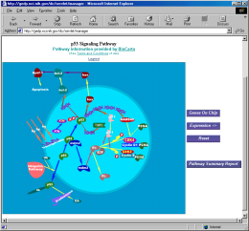
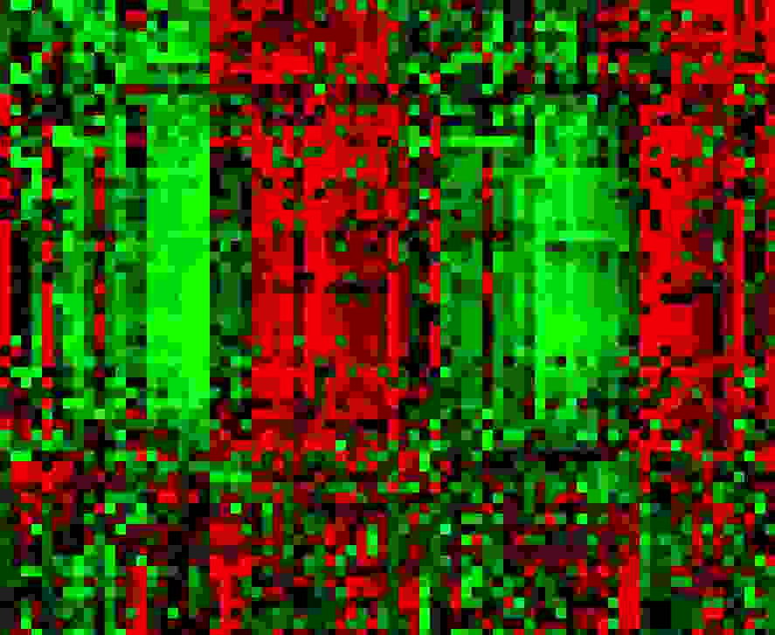
Cancer Biomedical Informatics Grid
caBIG will facilitate sharing of infrastructure, applications, and data
Notes:
2

Slide 3

In Vivo Imaging Workspace
Goals of the workspace
Advance imaging informatics on multiple fronts
Model methods to extract meaning from in vivo imaging data and establish databases to test and validate these methods
Create, optimize, and validate software tools
E.g. eXtensible Imaging Platform
Notes:
3

Slide 4

The eXtensible Imaging Platform (XIP) is the image analysis and visualization tool for caBIG
XIP is an open source environment for rapidly developing medical imaging applications from an extensible set of modular elements.
Imaging applications developed by research groups will be accessible within the clinical operating environment, using a new DICOM Plug-in interface first implemented in XIP.
XIP allows the research community to create custom image analysis and viewing applications for clinical trials using both caGRID and DICOM.

Slide 5
Major Parts of the
XIP Reference Host
XIP Libraries
XIP Reference Applications
XIP Development Tools
The top 3 combine to form an XIP Workstation

Slide 6
XIP Architecture
XIP Application
Custom
XIP Library
Classes
Standard
XIP Library
Classes
WG-23 API (Plug)
WG-23 API (Socket)
XIP Host
IVI Middleware caGRID Interface
DICOM/IHE Intefaces

Slide 7
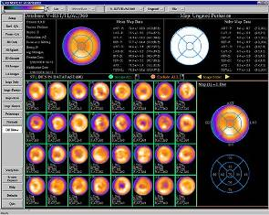
DICOM WG23 Plug-in Framework
WG-23 addresses clinical integration and vendor inter-operability by defining standardized “plugs” and “sockets” (APIs)
caBIG XIP addresses an open-architecture, integrated development environment for rapid prototyping & collaboration based on WG 23 APIs. It will be a reference implementation of those APIs
XIP developed Application
Standard API
…
Commercial Vendor #1
Commercial Vendor #2
Unix, Mac, PC
Internet Server
← Clinical →
← Prototype & Collaboration →
Notes:
For those of you that were not able to attend Fred Prior’s talk, I’ll first desc

Slide 8


Libraries
Sets of Open Inventor ® objects that XIP applications may utilize
Stock Open Inventor® objects for 3D graphics, modeling, UI, etc.
Standard XIP objects for retrieving data from, and storing data to XIP or DICOM WG-23 Hosts via the DICOM WG-23 interfaces
XIP objects that extend Open Inventor® objects with functions optimized for medical imaging applications, including MPR, image markup, annotations, etc.
XIP objects for accessing GPU hardware for volume visualization, filtering, etc.
VTK classes wrapped into Open Inventor® objects to support visualization
ITK classes wrapped into Open Inventor® objects to support image processing
Custom objects supplied by developers to extend XIP
Many XIP Libraries are host-independent, but if dependent on host services:
XIP libraries have internal dynamic ‘adapter’ libraries to allow for easy switching between XIP hosts or platforms (i.e. simply swap the dynamic library)
The XIP Application always sees the same Open Inventor® objects regardless of host
XIP libraries may be auto-generated from existing class libraries (e.g. ITK, VTK), or may be custom-built from new or existing code

Slide 9

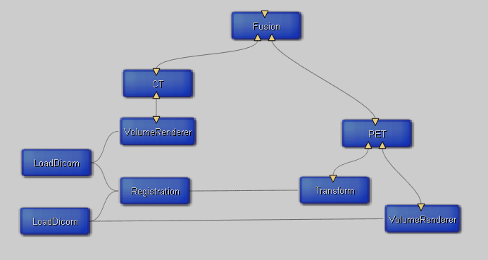
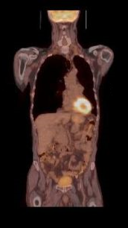
Open Inventor®
Open Inventor® is an object-oriented 3D toolkit for interactive graphics programming
Open Inventor® presents a programming model based on the Model/View/Controller design pattern
Open Inventor® includes both the Pipeline (for processing data) and Scene Graph (for visualizing data and models) concepts
Open Inventor® has a simple extension mechanism, making it easy to add new libraries (e.g. VTK, ITK) and functions
Open Inventor® modules represent Engines, Nodes and Manipulators

Slide 10
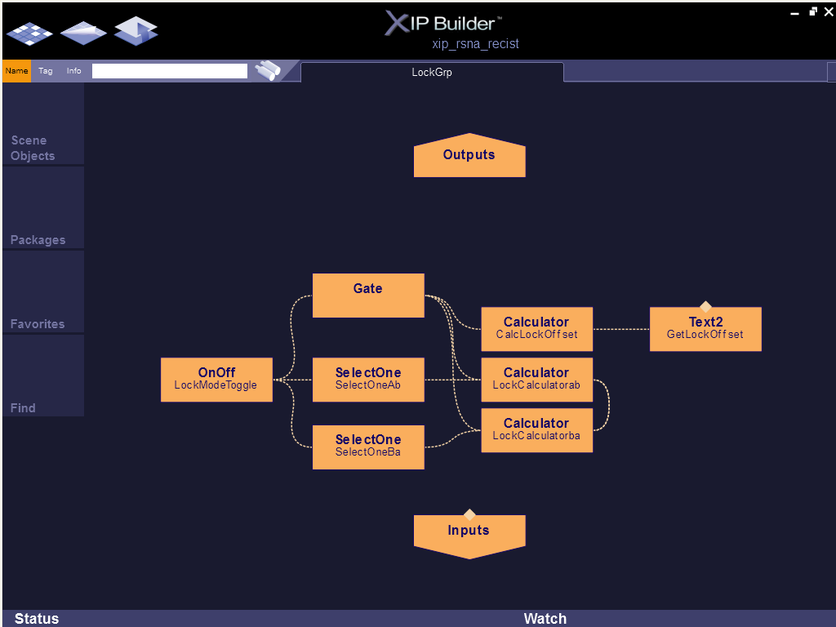
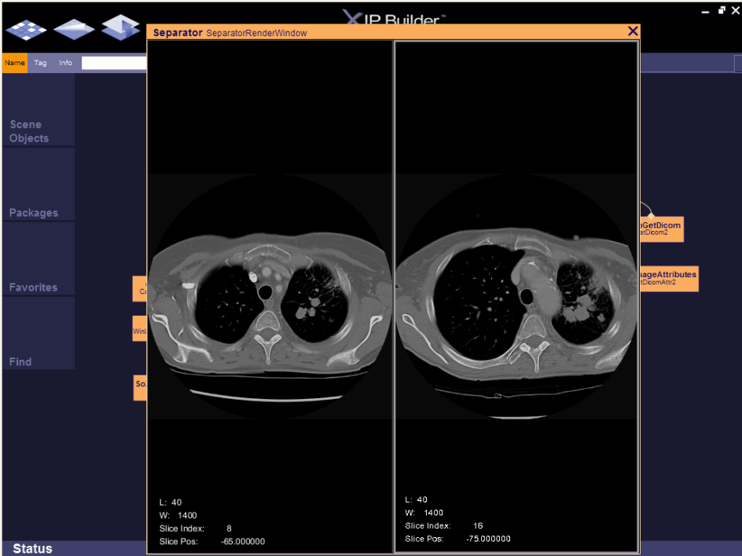
Applications
Applications formed from Interconnected Open Inventor ® engines, nodes, and manipulators from XIP Libraries
Engines enable the creation of processing pipelines and animation
Nodes support the concept of scene graphs, which are hierarchical structures of objects describing what needs to be visualized in 2D/3D, fed by the engines
Manipulators handle input devices, measurements and coordinate transforms in response to user interaction via a simple event model
Focused on the processing logic, not the infrastructure or data format
Skinnable GUI engine for different look-and-feel on different platforms

Slide 11
Example – RECIST measurement tools
A custom set of applications for managing a multi-center clinical trial where tumor progression is measured using the RECIST criteria.
The Baseline Rater Application is used by readers at multiple sites to
Identify up to 10 target lesions to track
Make the initial measurement of the longest diameter
Record the initial observations
The Baseline Adjudication Application is used by a single individual to
View the measurements from several raters
Generate a consensus decision of the target lesions, initial measurements and observations
The Follow Up Rater Application is used by multiple readers to make follow up measurements and observations of the target lesions.
The Follow Up Adjudicator is used by a single individual
View the measurements from several raters
Generate a consensus decision of the target lesions, initial measurements and observations

Slide 12
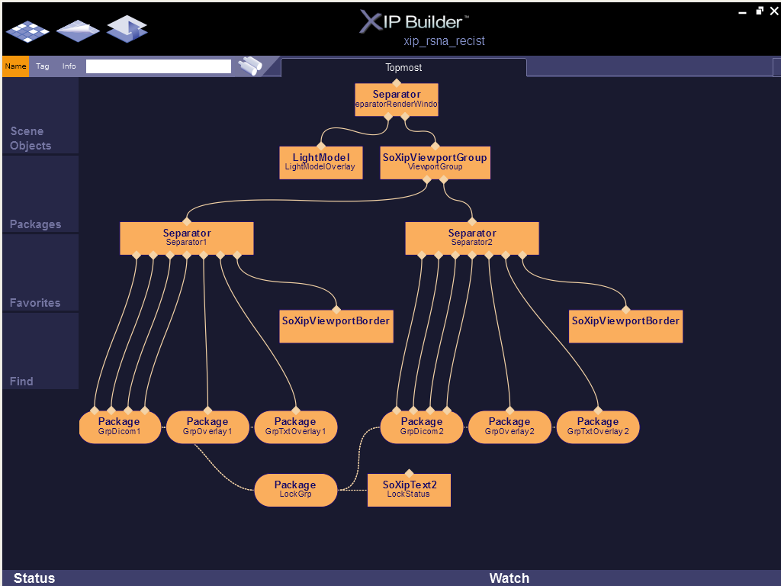
^{Application Developer} may use the XIP Builder tool to create the app’s scene graph and processing pipelines

Slide 13
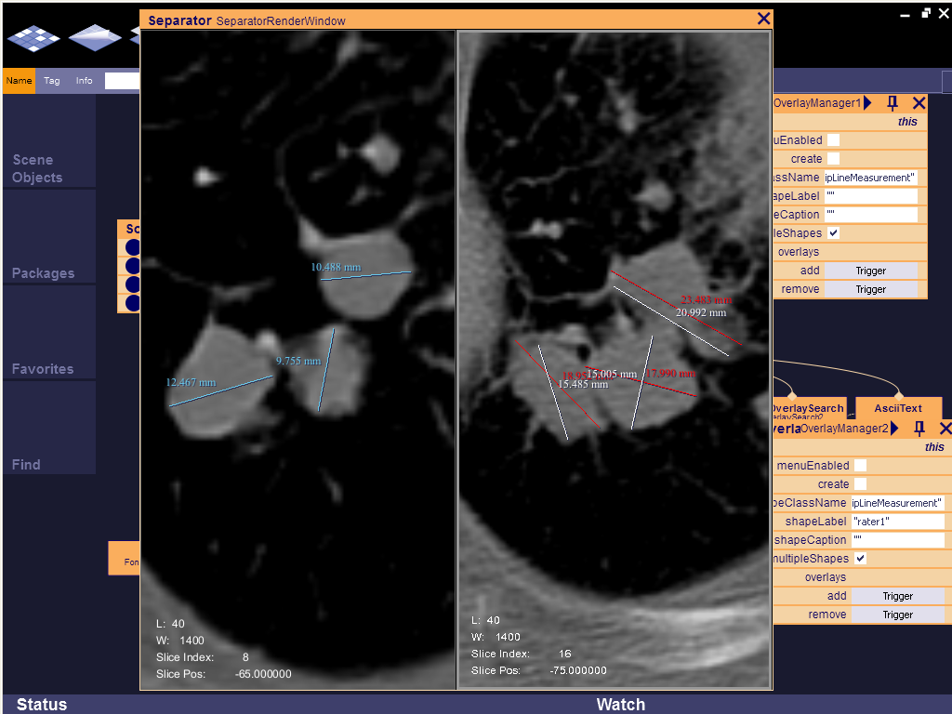
The XIP Builder tool can be used to test and debug the scene graph

Slide 14
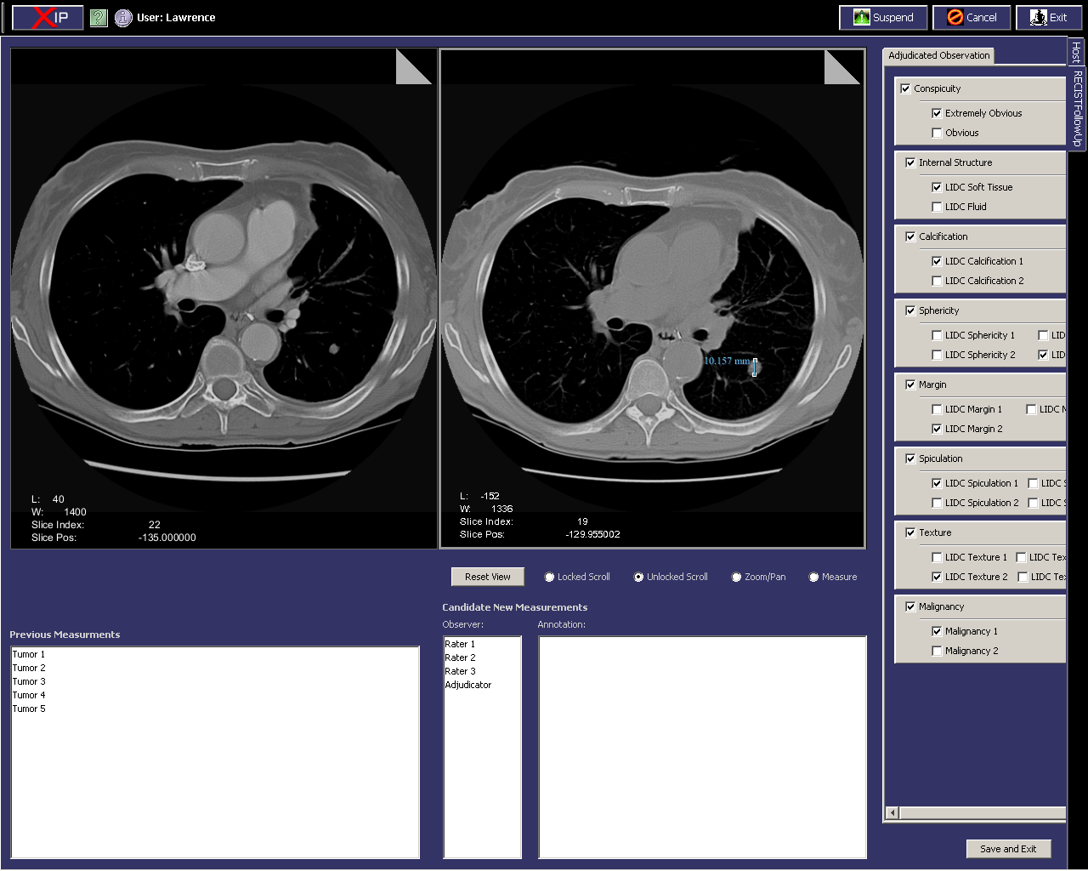
Application Developer controls the scene graph by creating a GUI program (e.g. via Java Swing)

Slide 15
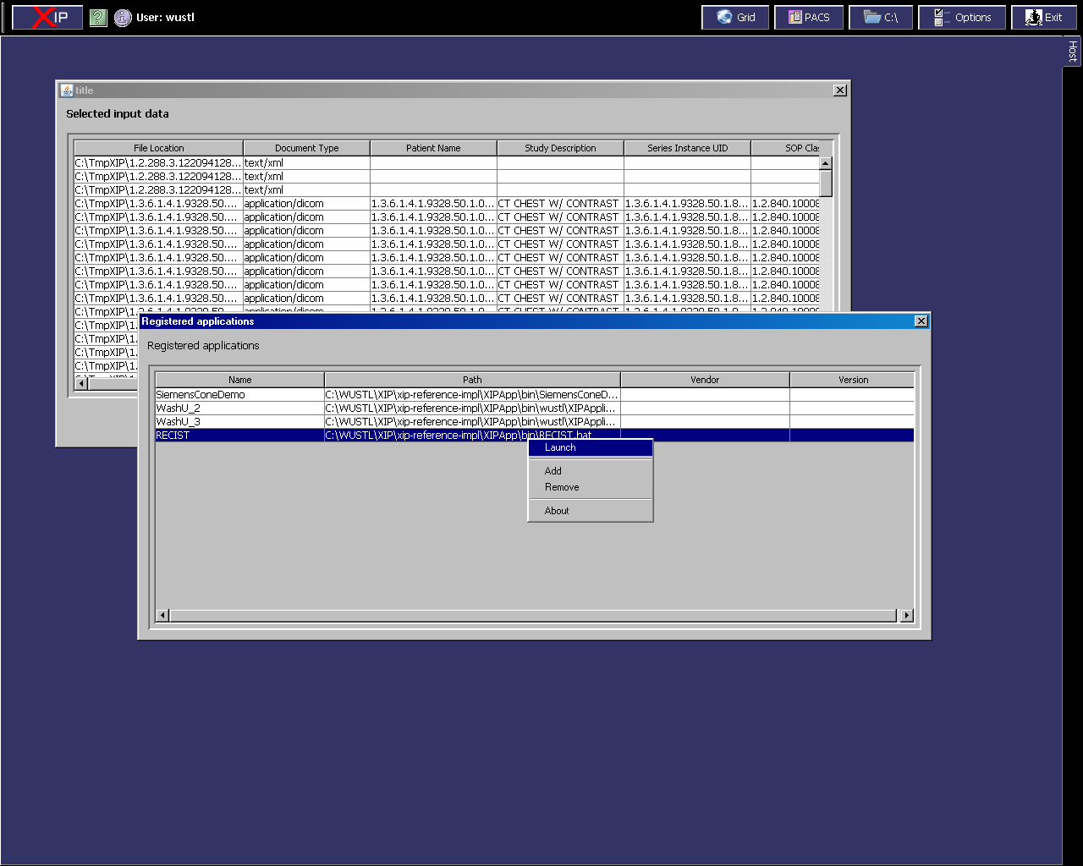
Host
Provides the infrastructure in which XIP or DICOM WG-23 Applications run
Authenticates user
Manages installation, launching, and termination of XIP Applications
Provides data and services to XIP Applications
Accepts status information and results back from XIP Applications
Deals with auditing and controls access to services and data
Isolates the XIP application from the nature of databases, archives, networks, and possibly image data formats
Manages caGRID interactions and security
Manages access to DICOM networks, objects, and services
Maps images and associated meta-data between
their native form and a common form useable by
the XIP application
Handles workflow issues
IHE General Purpose Worklist support
Supports any application that follows DICOM WG-23
Application Hosting Interface Standard

Slide 16
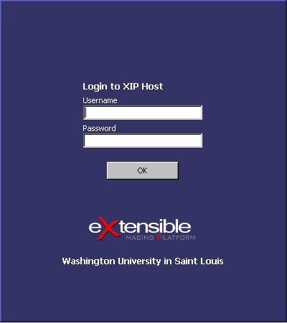
Host Identifies and Authenticates the User
HIPAA Audit Trails
Tracking who made the observations
Generating custom Worklists

Slide 17
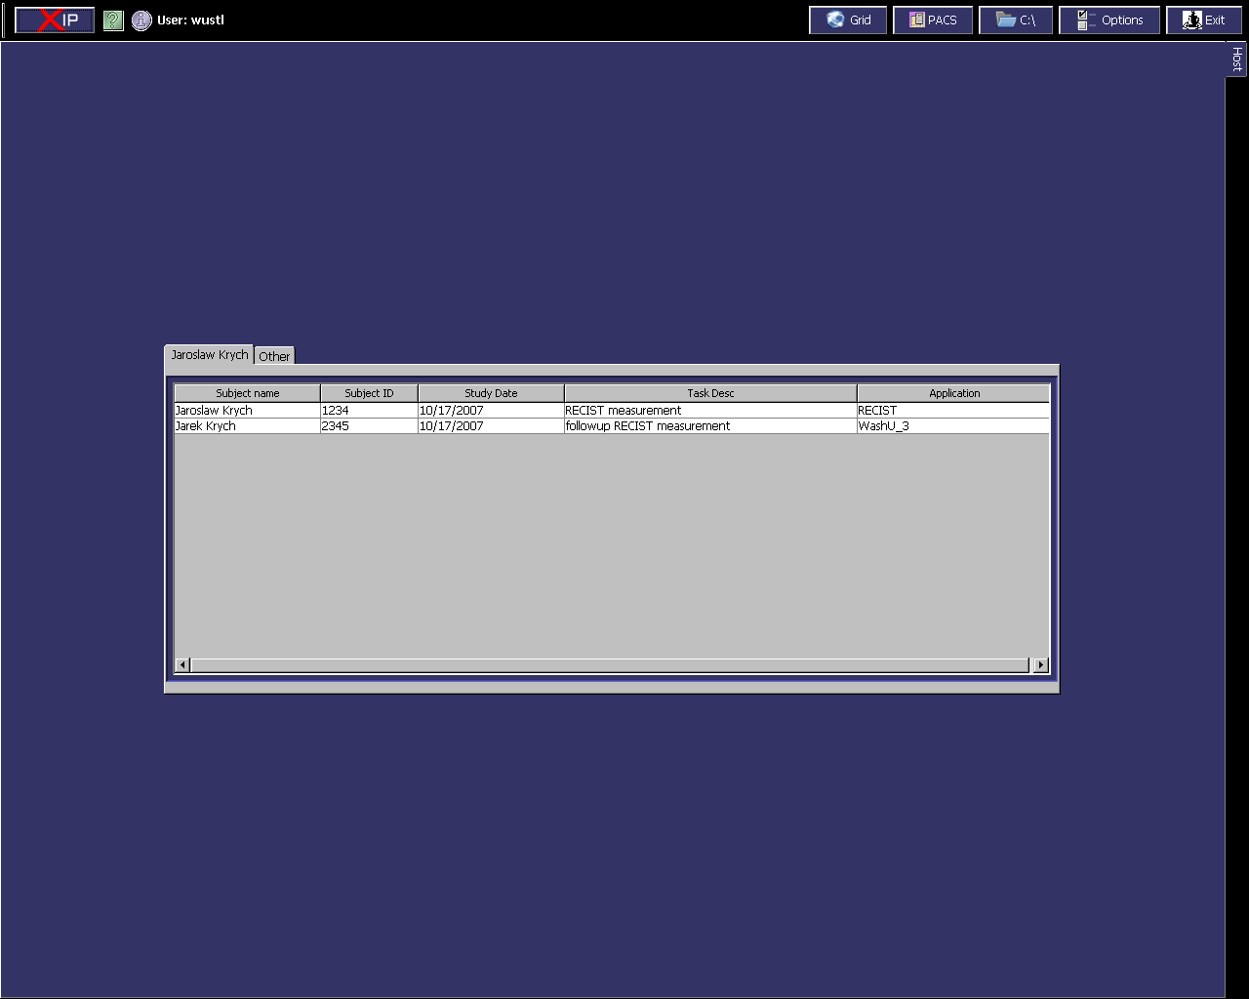
Worklist Identify Data and Application to Run

Slide 18
Host Launches Application

Slide 19
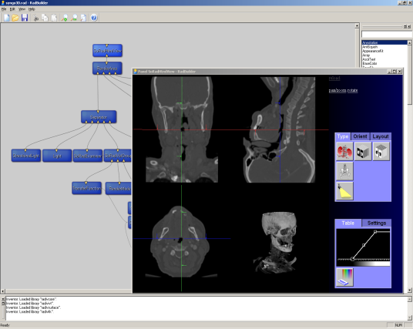
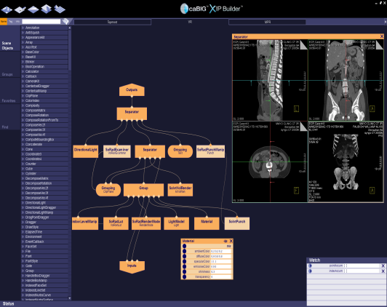
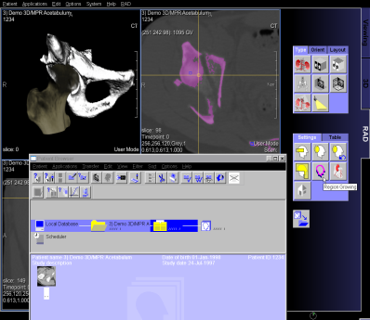
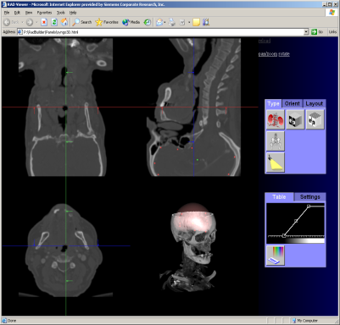
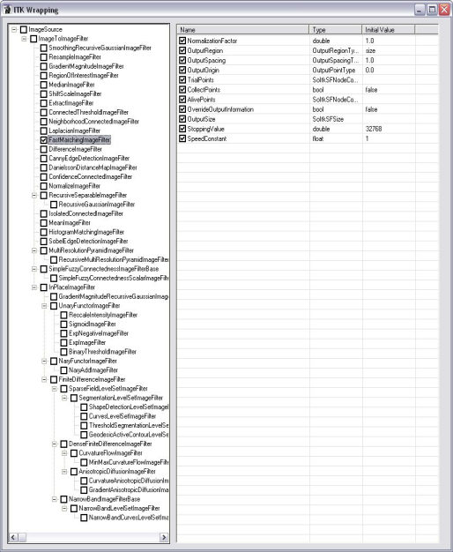
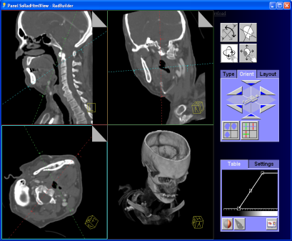
XIP Application Builder
Medical Imaging Workstation
XIP Development Process
Distribute
XIP Application
XIP Modules
Host Independent
XIP Host Adapter
Web-based Application
ITK
VTK
XIP LIB
. . .
WG23
WG23
WG23
WG23
Distribute
XIP Host
(Can be replaced with any DICOM WG23-compatible Host)
Host-Specific Plug-in Libs
DICOM, HL7, & other services per IHE
caGRID Services via Imaging Middleware
Distribute
Standalone Application
XIP Class Library
Auto Conversion Tool

Slide 20


Slide 21
Other Applications developed using precursor XIP tools

Slide 22
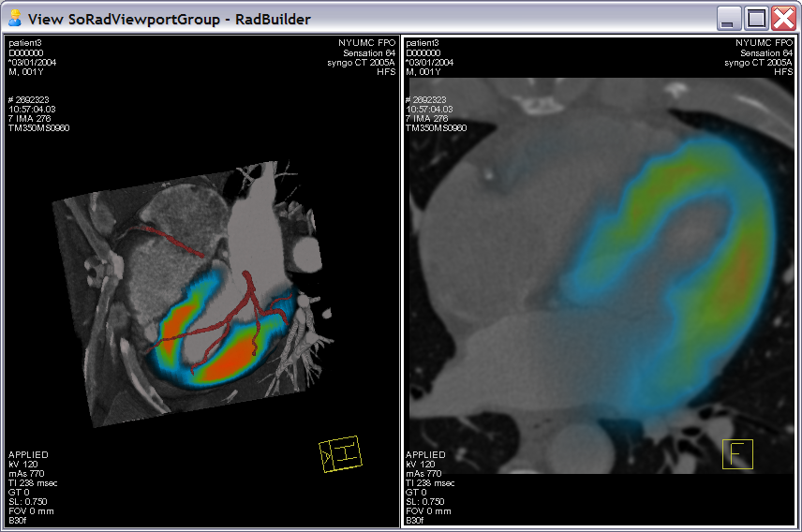
Fused Volume Rendering (screen shot of live demo)

Slide 23
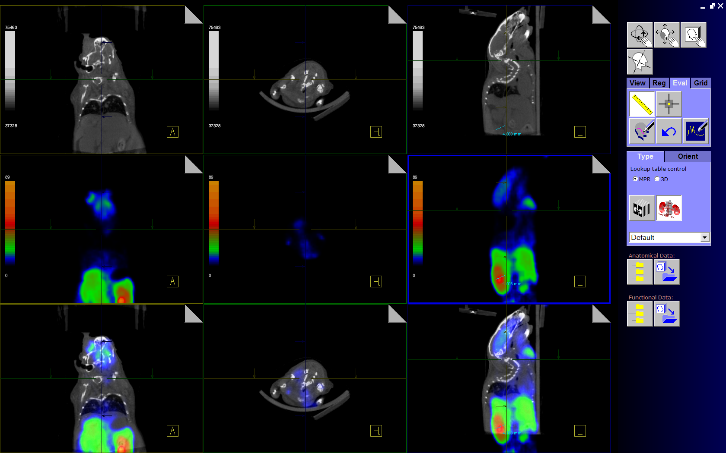
Animal Imaging Prototype (screen shot of live demo)

Slide 24
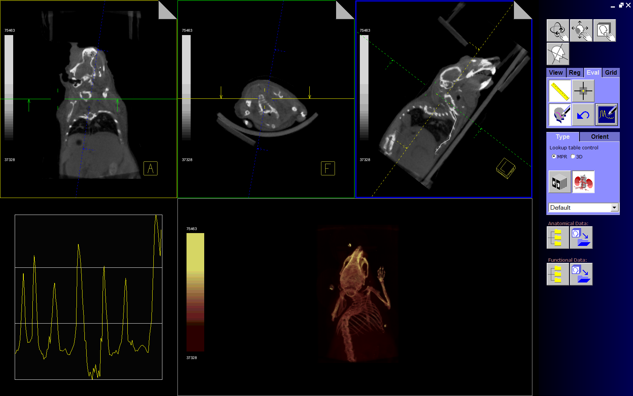
Animal Imaging Prototype (screen shot of live demo)

Slide 25
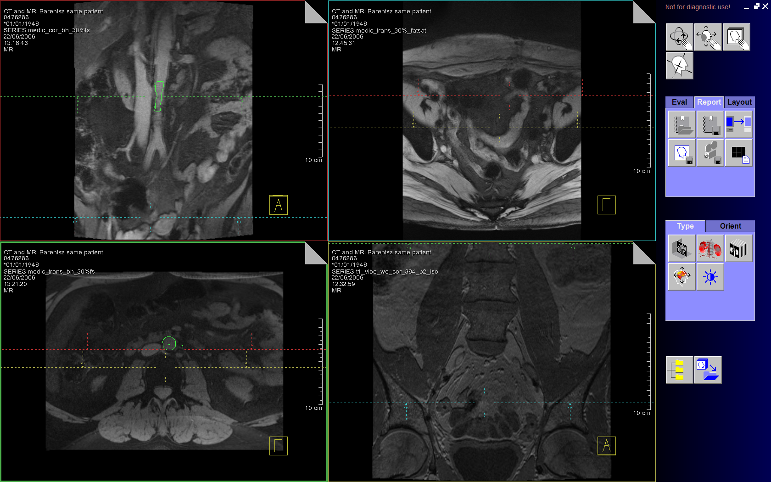
Lymphnode Segmentation (screen shot of live demo)

Slide 26
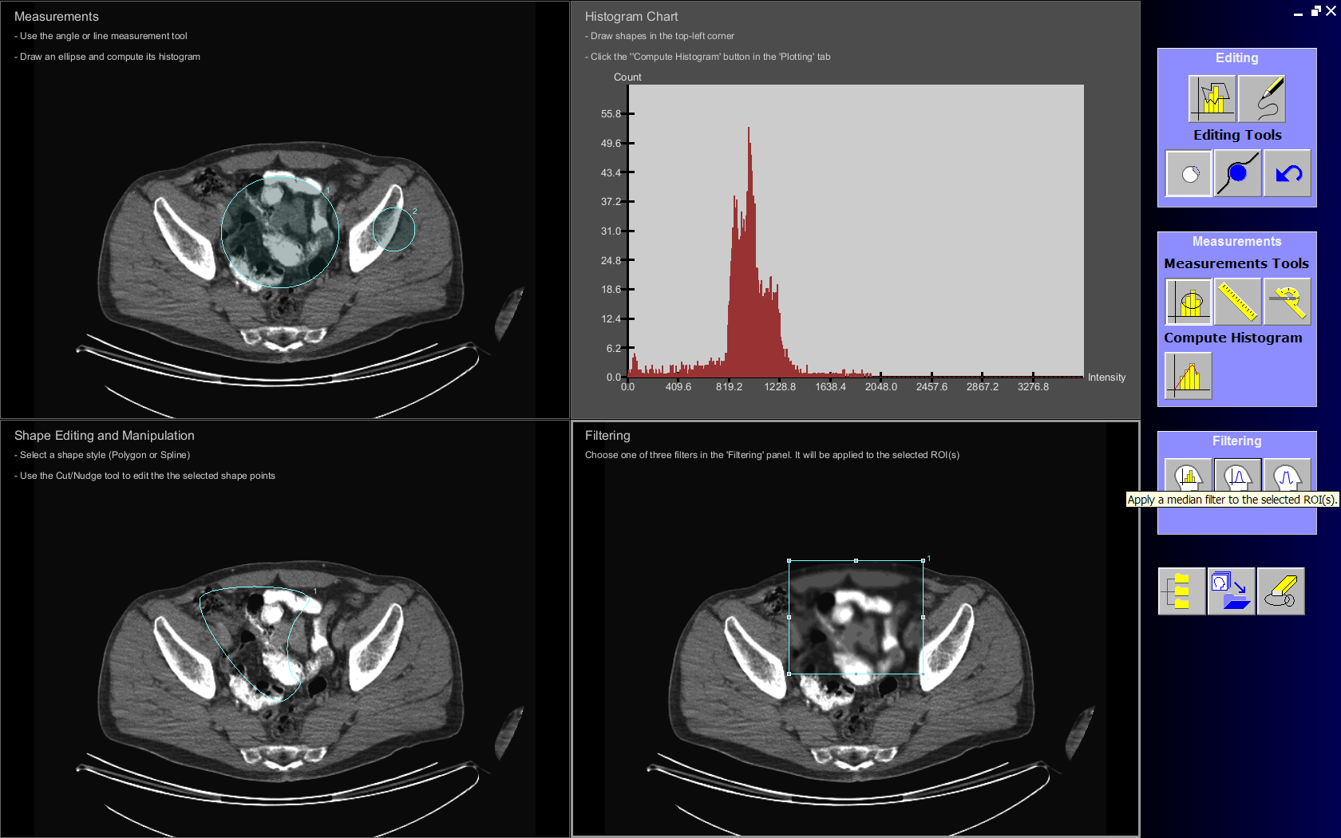
ROI Tools, Measurement and Filtering (screen shot of live demo)

Slide 27
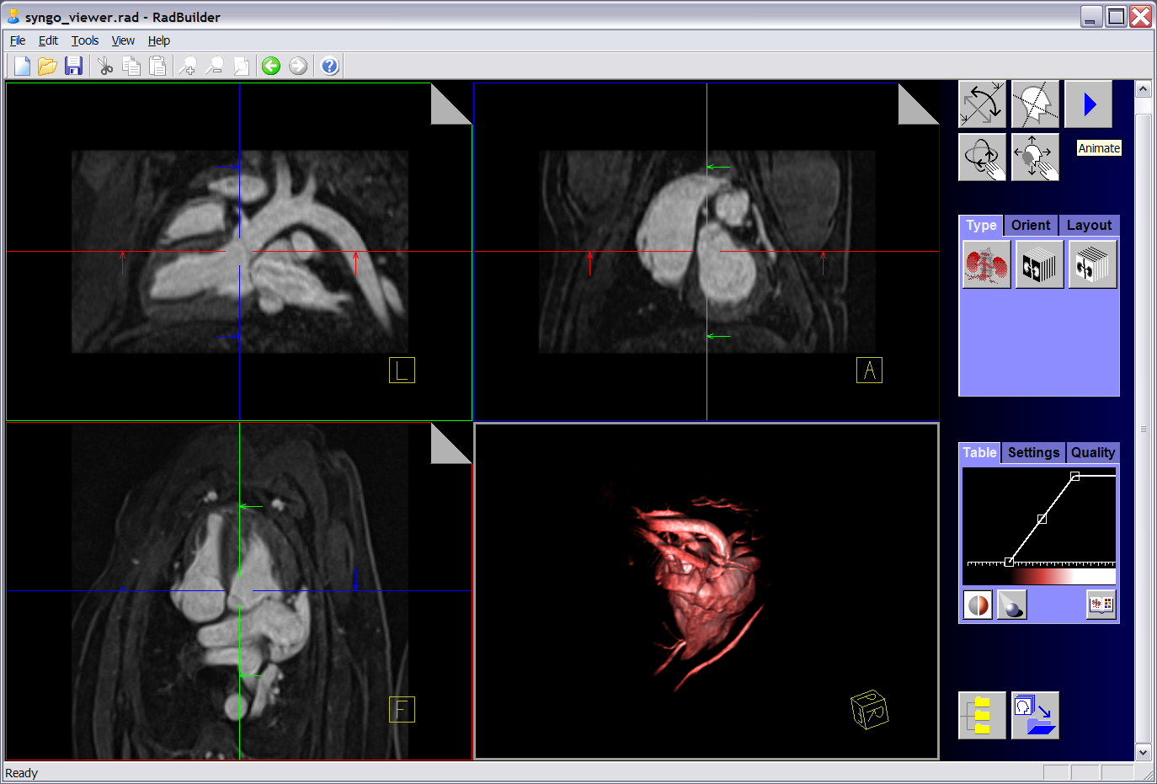
4D Beating Heart (screen shot of live demo)

Slide 28
Propose Future Applications

Slide 29

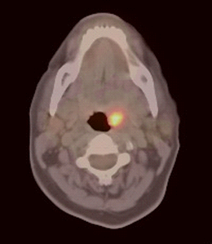
Use Case – Agent-Specific Post Processing
2. System selects ‘plug-in’ app based on agent
1. System identifies the agent
‘Plug-in’ app performs agent-specific analysis
SPECT
MR
SPECT
MR
CT
CT
PET
PET
PACS
PACS
SPECT
PACS
MR
SPECT
MR
CT
CT
PET
PET
Image Workstation
Image Workstation
Plug
Plug
-
-
in Extension
in Extension
Molecular Imaging Plug
Molecular Imaging Plug
Molecular Imaging Plug
-
-
-
in Server
in Server
in Server
--
--
--
Agent Specific Acquisition/Recon
Agent Specific Acquisition/Recon
Agent Specific Acquisition/Recon
--
--
--
Agent Specific Image Analysis
Agent Specific Image Analysis
Agent Specific Image Analysis

Slide 30
Use Case – SOP-Specific Post Processing
New or Private SOP classes may be unknown to a workstation
e.g. Radial IVUS images
Workstation could look for a ‘plug-in’ application that does know how to handle the unknown SOP Class

Slide 31
Use Case – CAD/Screening Applications
‘Plug-in’ applications are fed sets of DICOM objects to analyze, from which they produces DICOM Evidence Documents
‘Plug-ins’ could run
on a common server
on the central archive
on a manufacturer-supplied server
as a remote service

Slide 32
Use Case – Mammography Image Storage
Desire to archive both raw and processed data
Processed data to show what was used for the diagnostic report
Raw data for potential future enhancements
No desire to double storage requirements!
Solution – store raw plus reference to a processing application

Slide 33
Use Case – Multi-site Trials/Research
Need to perform the same analysis on images collected at multiple sites
Sites have multiple working environments
Trial coordinator would like to create a single analysis package that could be run at all sites

Slide 34
Other Use Cases
Customized Reporting and Display
Site-specific reports
Print Composing
Custom printing across multiple systems
Analysis of Image Data in Repositories
Faster to move apps than data
…

Slide 35
Summary
XIP provides the ability to create rapidly create applications customized to specific tasks.
DICOM WG-23 interfaces allow those applications to run on any workstation that supports the standard interfaces
XIP includes a reference host implementation
Other vendors may eventually host applications
XIP with DICOM WG-23 represent new paradigm for writing and distributing medical imaging applications

Slide 36
XIP Development Team
Washington University in St. Louis
Lawrence Tarbox
Jaroslaw Krych
Kirk Smith
Paul Koppel
Steve Moore
Michael Pringle
Fred Prior
Others
Other Consultants
Kitware
Siteman Cancer Center
Related Projects
IVI Middleware
AIM
Open Inventor™
ITK & VTK
Open Healthcare Foundation (OHF)
NCIA
MIRC
Siemens Corporate Research
Gianluca Paladini
Thomas Moeller
Julien Gein
Babu Samuel
Daphne Yu
Klaus Engel
Ravi Kumar
Ranajoy Malakar
Anthony Dass
John Pearson
Others
NCI caBIG IVI
Eliot Siegel
Vikram Purohit
Others
Booz Allen Hamilton
Paul Mulhern
Others

